Slide 1
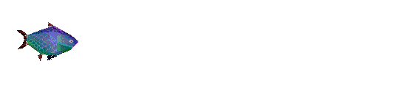
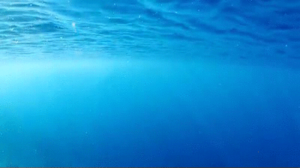
A Fishy Analysis
By Mike Lawrence

Slide 2
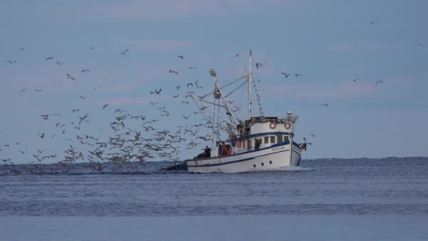
Ever see this in the San Diego harbor?

Slide 3
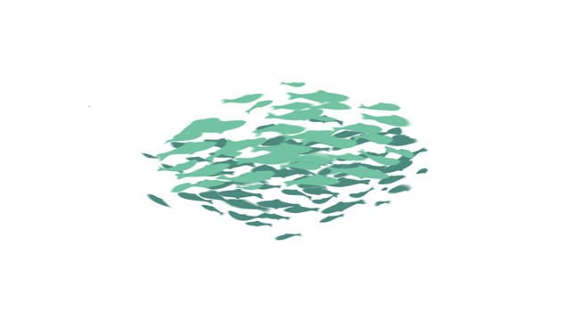
Catch of the Day (🐠 Agenda 🐠)
We’re going to:
Learn about sportfishing
Use webscraping to collect data from the internet
Dive into some NLP (natural language processing) to understand text data
Notes:
https://www.sandiegomagazine.com/features/a-deep-dive-into-the-san-diego-fishing-industry/article_2959b344-d518-5cf0-b2d7-a952673fc231.html
Article that highlights rebound of tuna populations and sustainable fishing in san diego

Slide 4
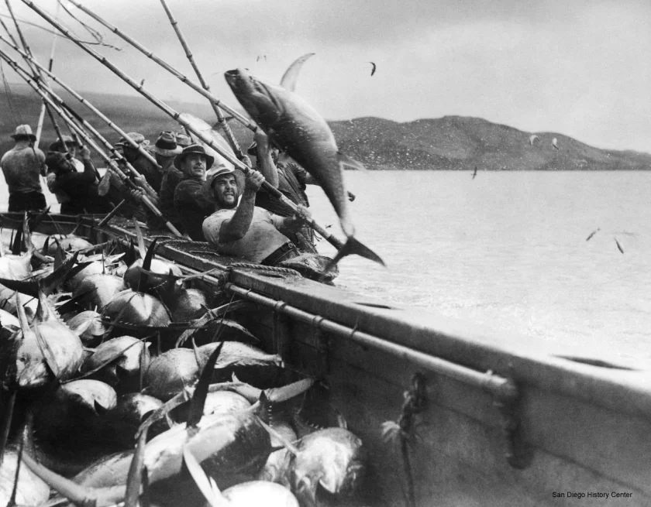
Deep-Sea Fishing in San Diego over the past ~100 years
*all excerpts from SD Union Tribune
Fun facts:
Tuna used to be San Diego’s third-largest industry (first cannery opened in 1909)
San Diego touted as “tuna capital of the Pacific,” canning 95% of packed tuna by 1940
Lawmakers protect dolphins in 1972, prompting local ships to shift operations to western Pacific and South America.
Notes:
Photo: https://www.sandiegouniontribune.com/business/growth-development/sdut-tuna-san-diego-fish-story-2012jun16-htmlstory.html
1950s tuna was huge here
But 50 years ago, tuna was San Diego’s third-largest industry, behind the Navy and aerospace. It employed some 40,000 San Diegans in catching, canning and marketing the product. Two of the three big tuna canning companies were based here, and the waterfront was home to four canneries and scores of fishing boats

Slide 5
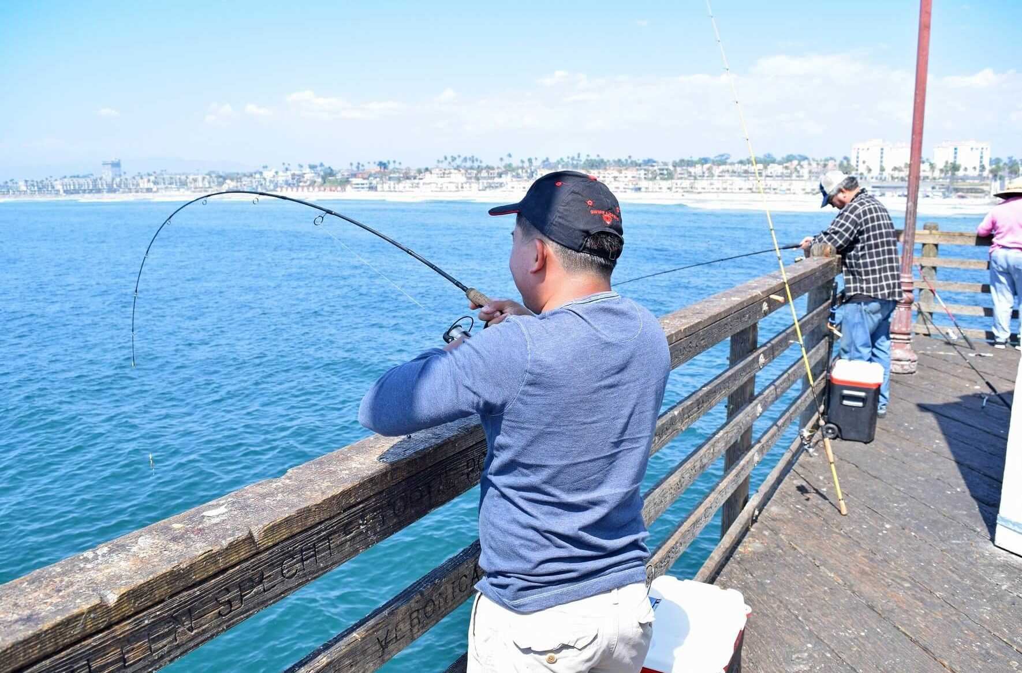
Today’s ecosystem
Heavy regulation on fish you can keep
More recreational than commercial
Lakes and rivers are overfished - ocean is much easier!
Notes:
The

Slide 6
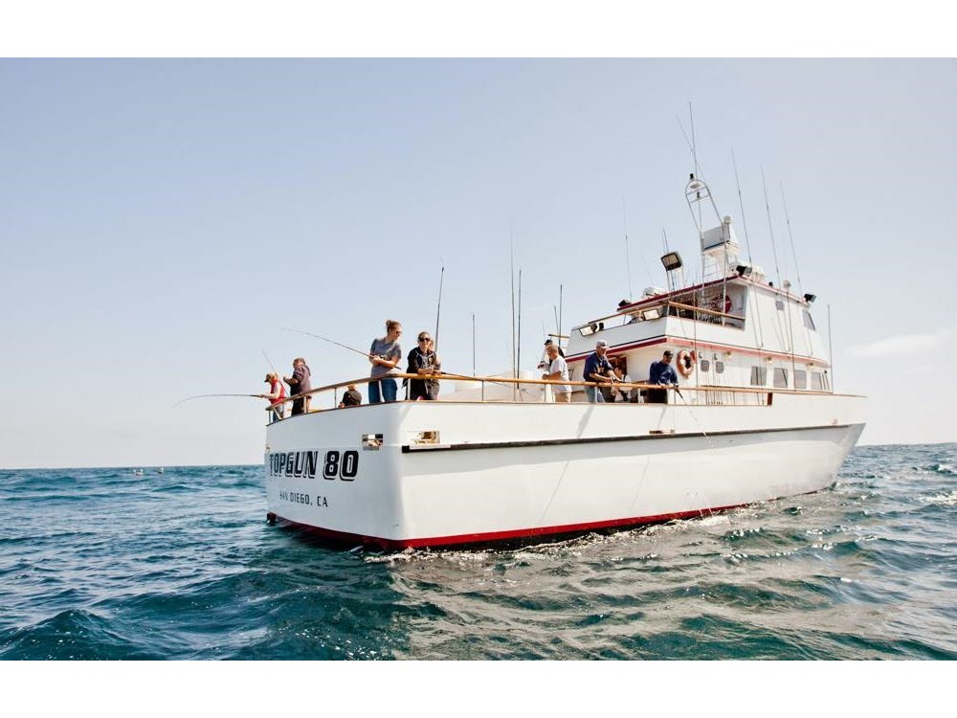
Today’s ecosystem
Notes:
There are kelp forests nearby you can visit with short trips, or go out to Mexico or international waters

Slide 7
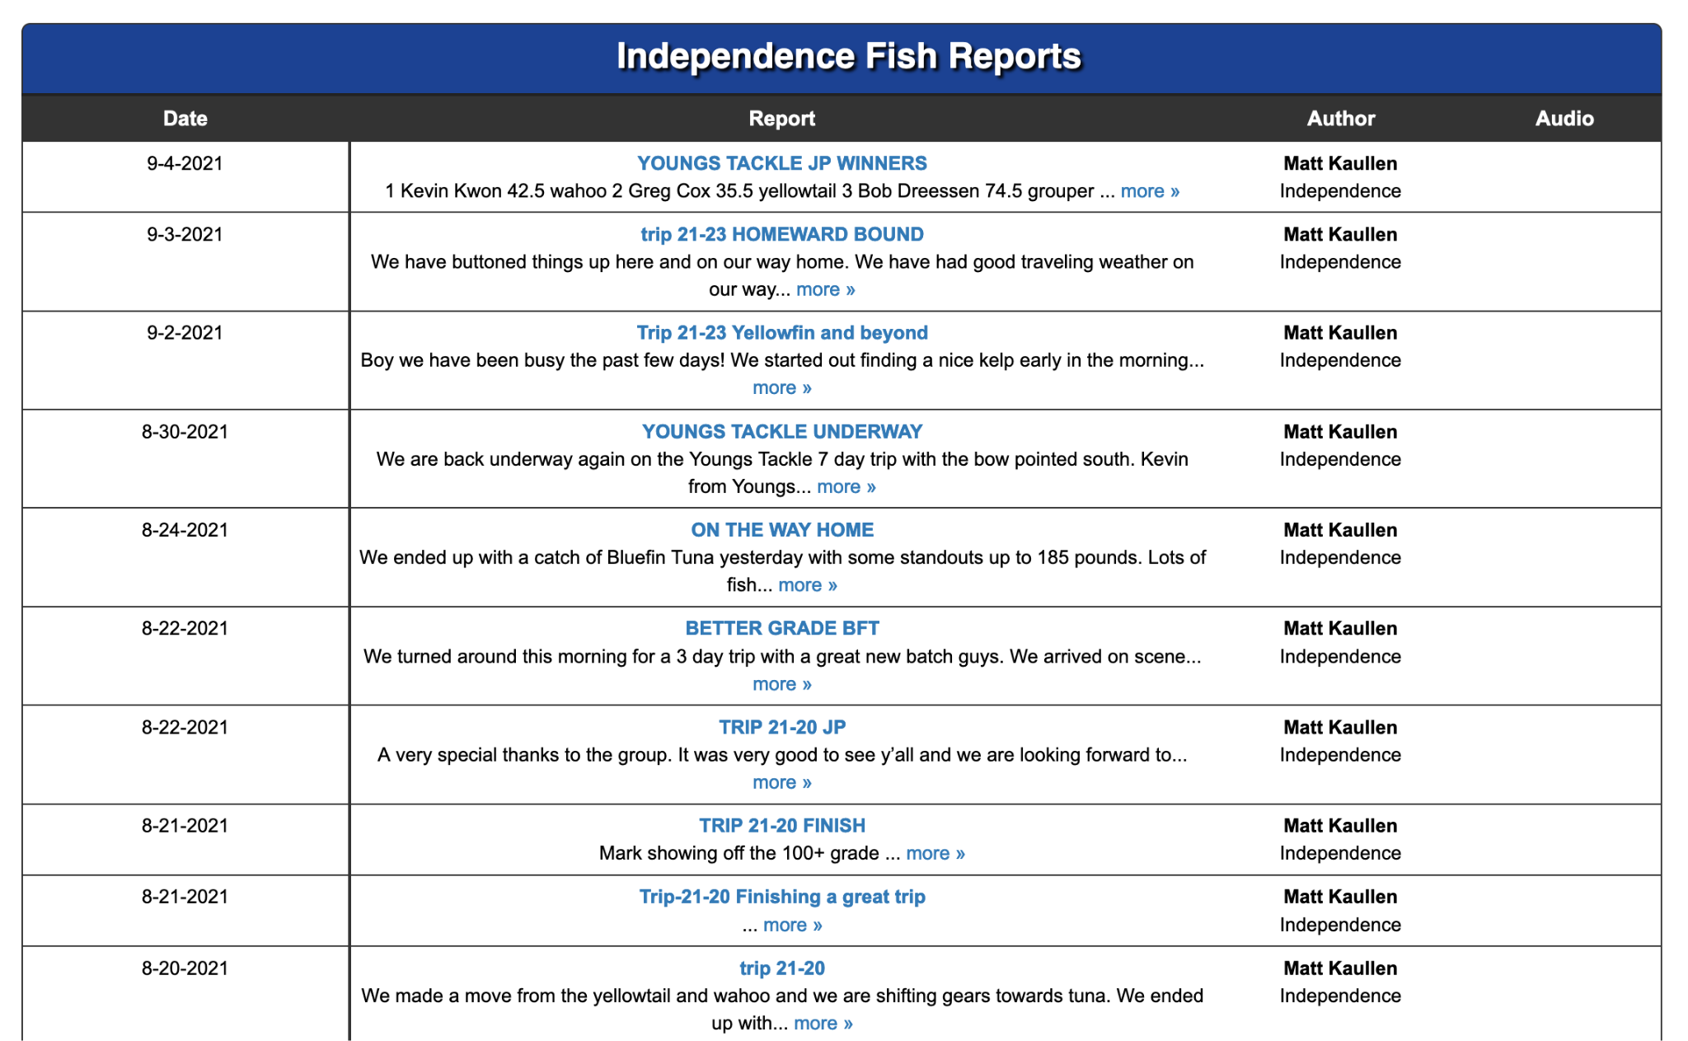
Today’s ecosystem
Notes:
Boats post updates when they can, sometimes multiple per day

Slide 8
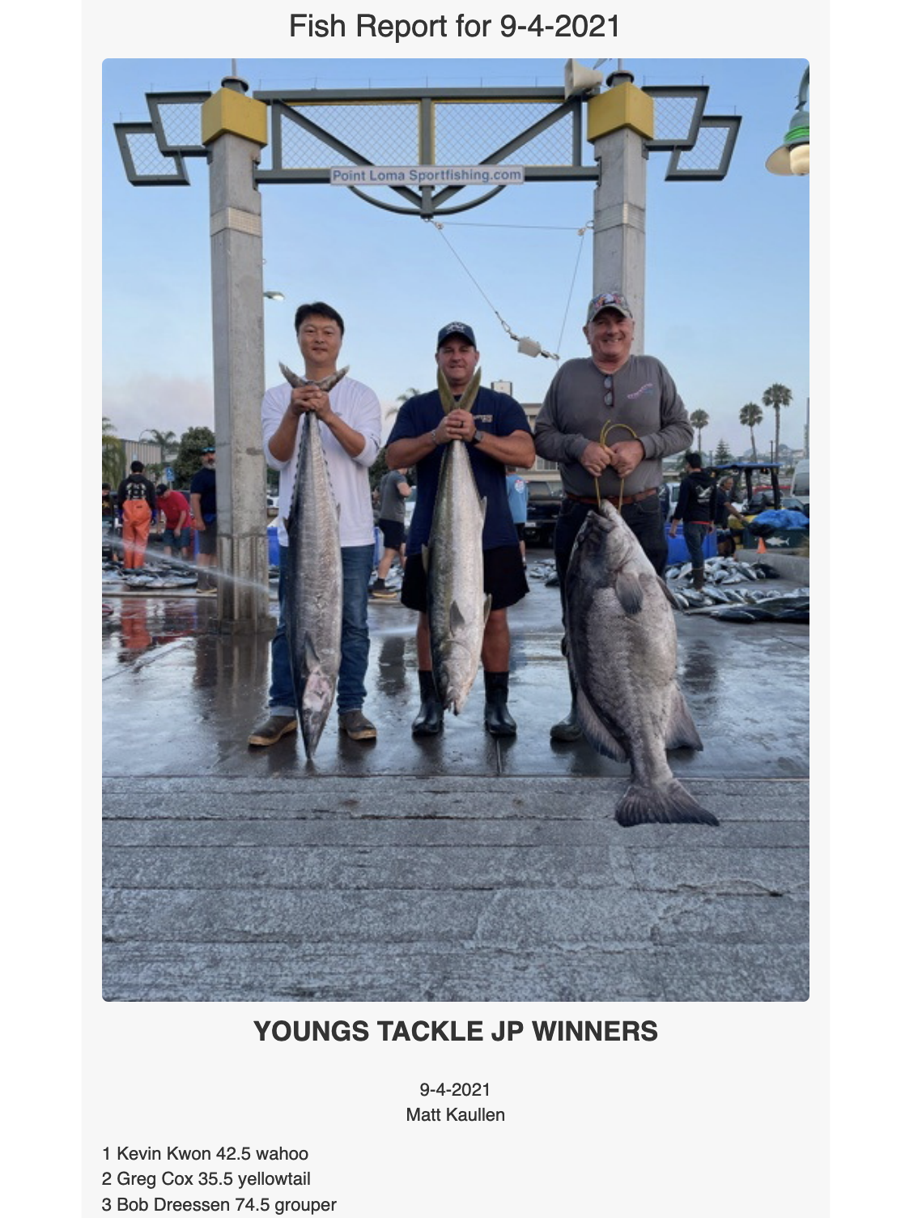
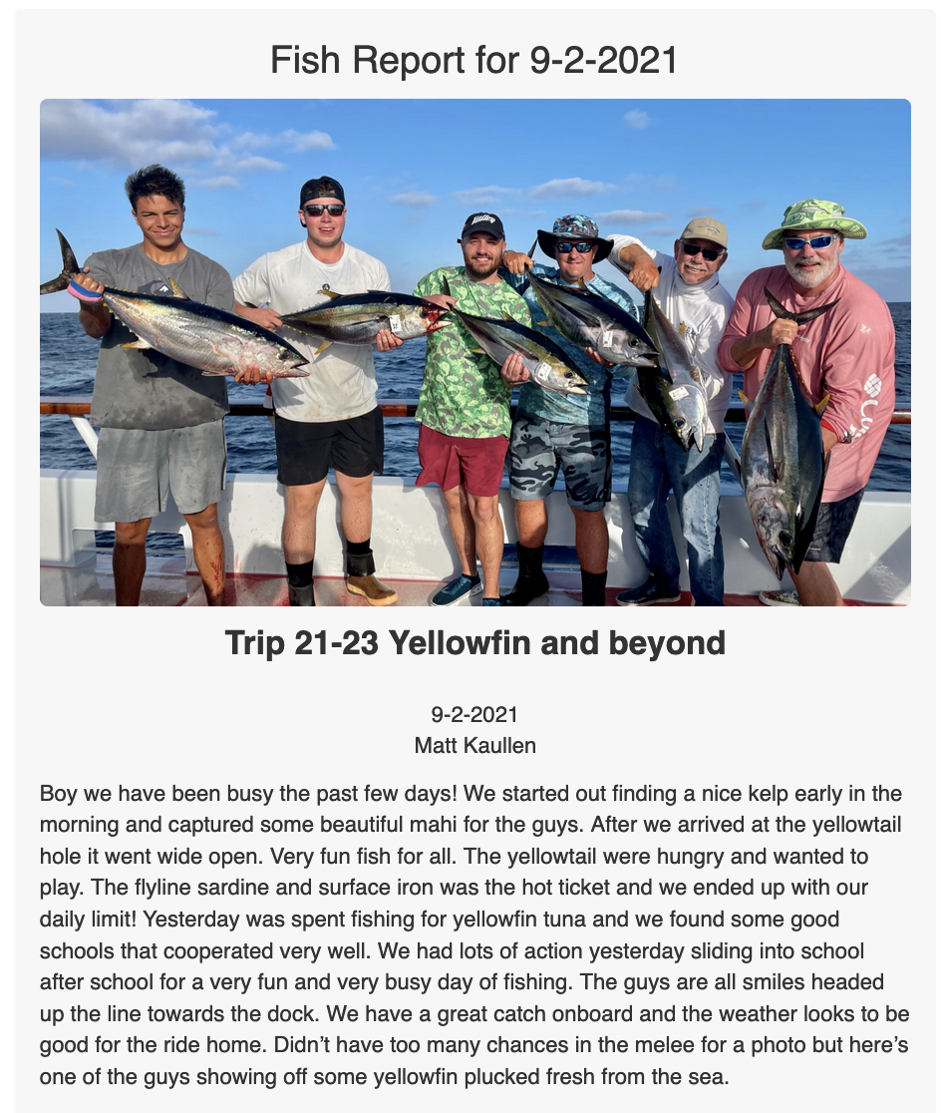
Today’s ecosystem

Slide 9
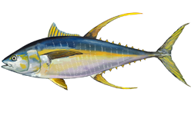
Some questions to explore
What is the culture of the boats like? What do they post about?
What fish do they catch?
When is the best time to go?
Does weather matter? We’ll be skipping this due to data constraints
Notes:
Whatre they talking about? Do they have any type of specialized language?

Slide 10
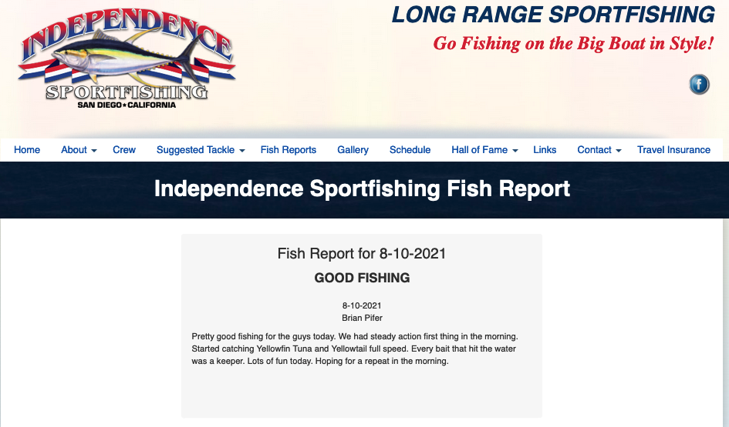
What we’re analyzing
Date
Captain’s notes
Notes:
https://www.independencesportfishing.com/fishreports.php

Slide 11
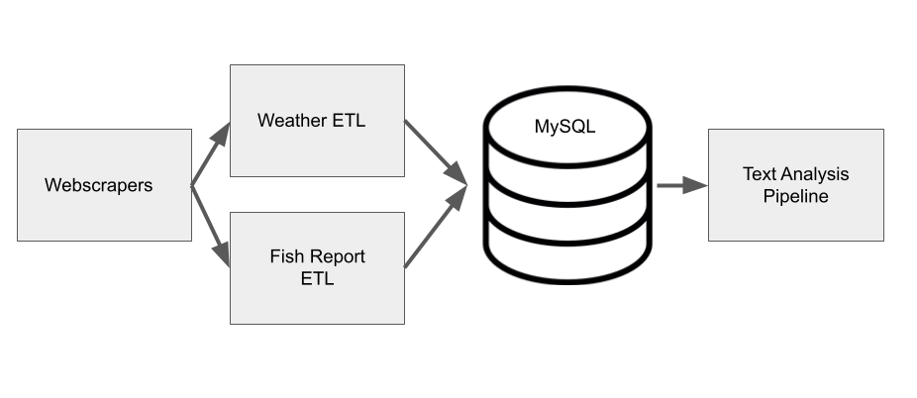
Collecting data
We’ll only skim over this
Notes:
To learn about these posts we need to extract some data

Slide 12
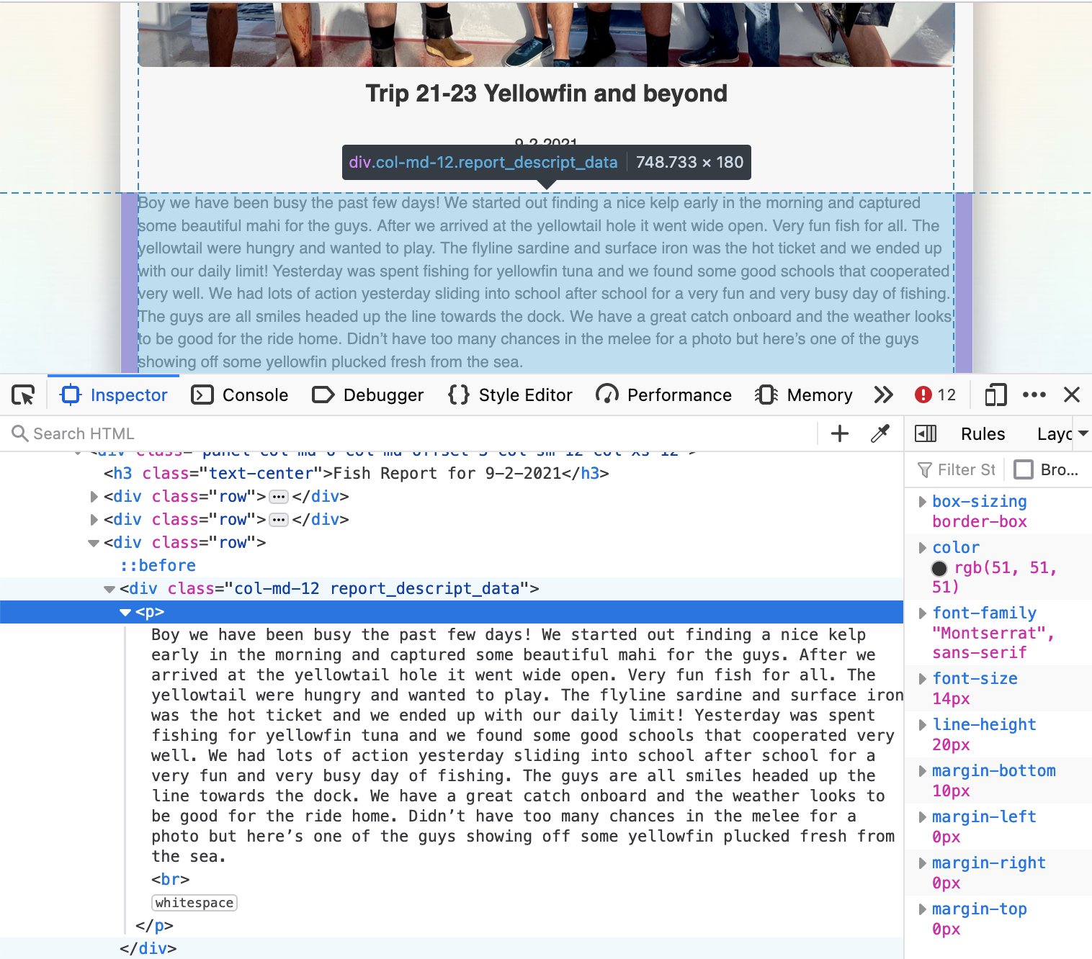
Webscraping

Slide 13
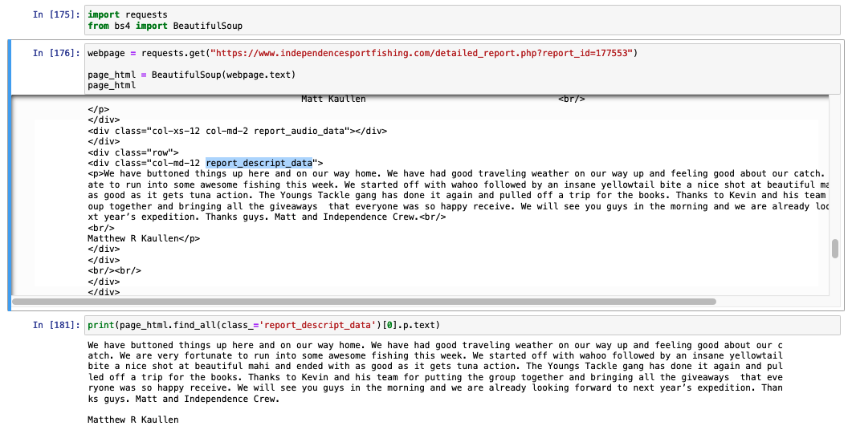
Webscraping

Slide 14
Webscraping
Filter webpage by HTML elements

Slide 15
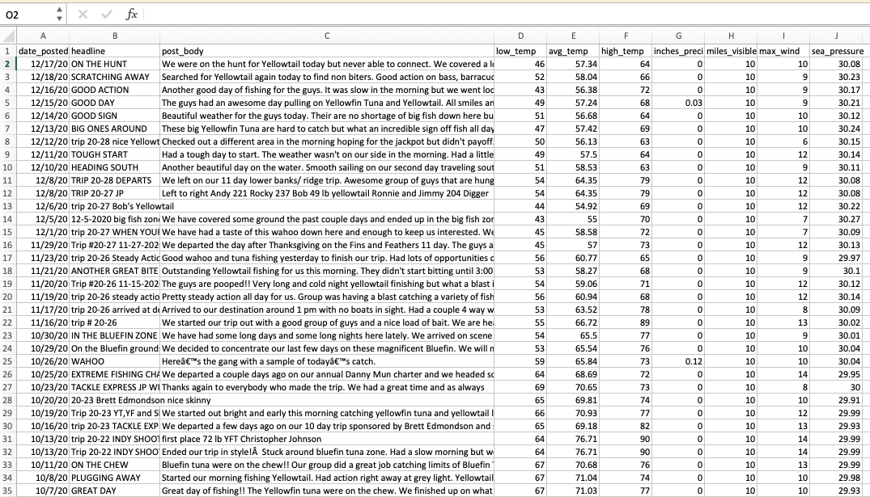
The data (~3k posts, from 2005 to 2020)

Slide 16
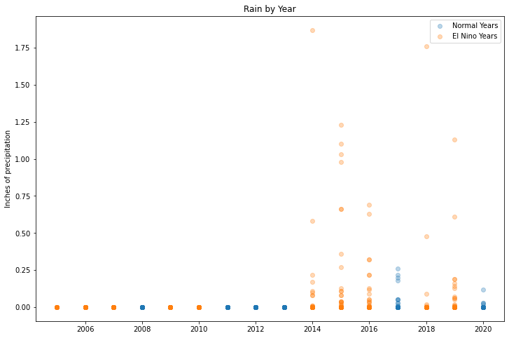
Weather database online has missing data :(

Slide 17
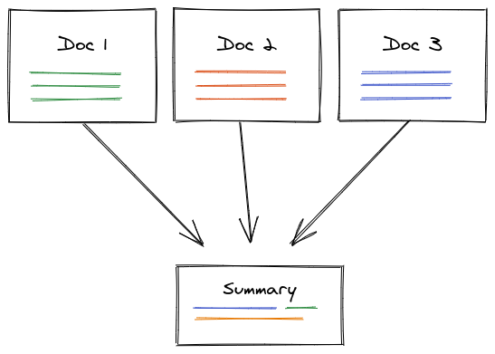
What are they talking about in these posts?
Text summarization methods → understand boat culture

Slide 18
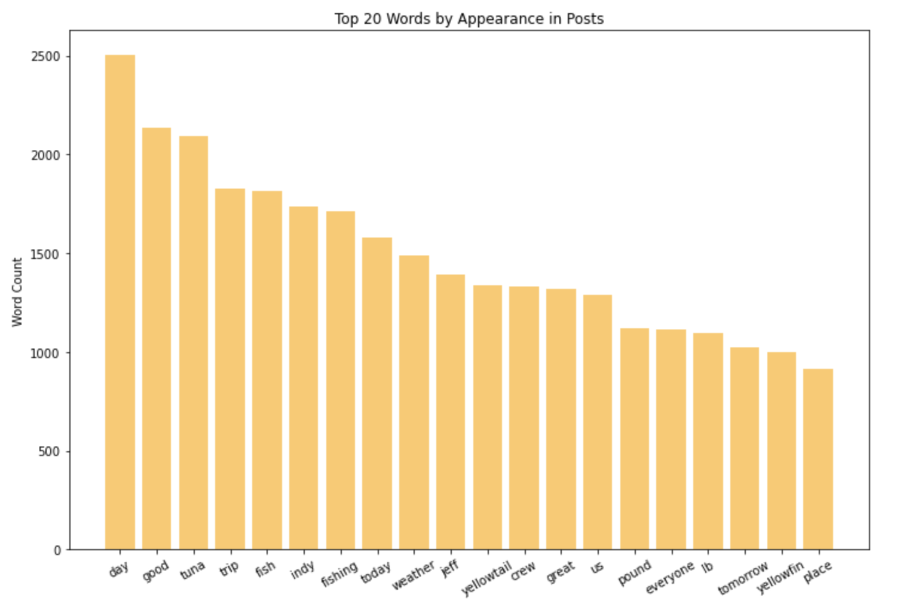

Slide 19
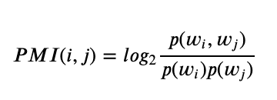


Beyond single words - Phrases via PMI
Words that occur together frequently are likely to be phrases *if* the words aren’t generic.
“Wells Fargo”
“and the”
High PMI → phrase likely
Low PMI → phrase unlikely

Slide 20
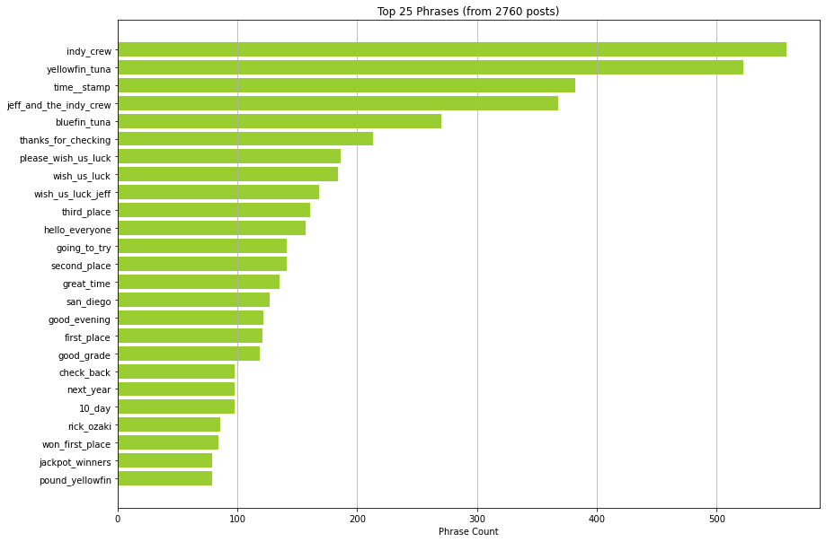
Top phrases

Slide 21
Top phrases
Tuna!
Rankings!

Slide 22
Today’s ecosystem
Attendees are ranked, and the popular phrases show this

Slide 23
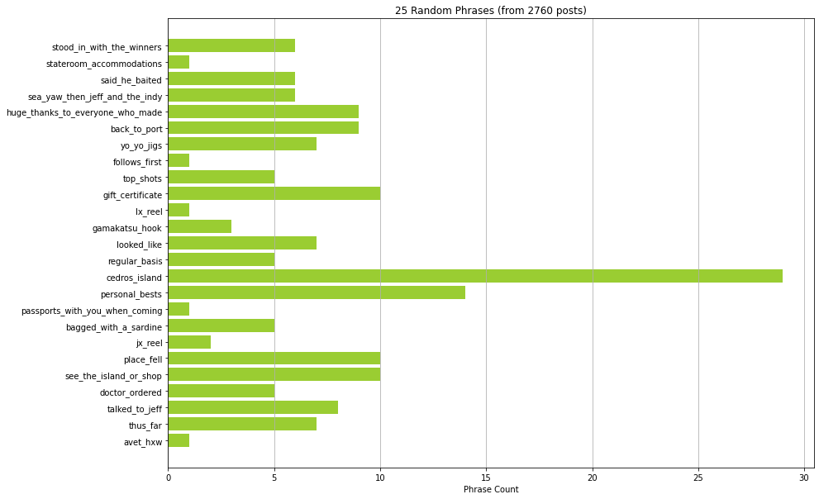
A few random phrases
Cedros Island?
Passports?

Slide 24
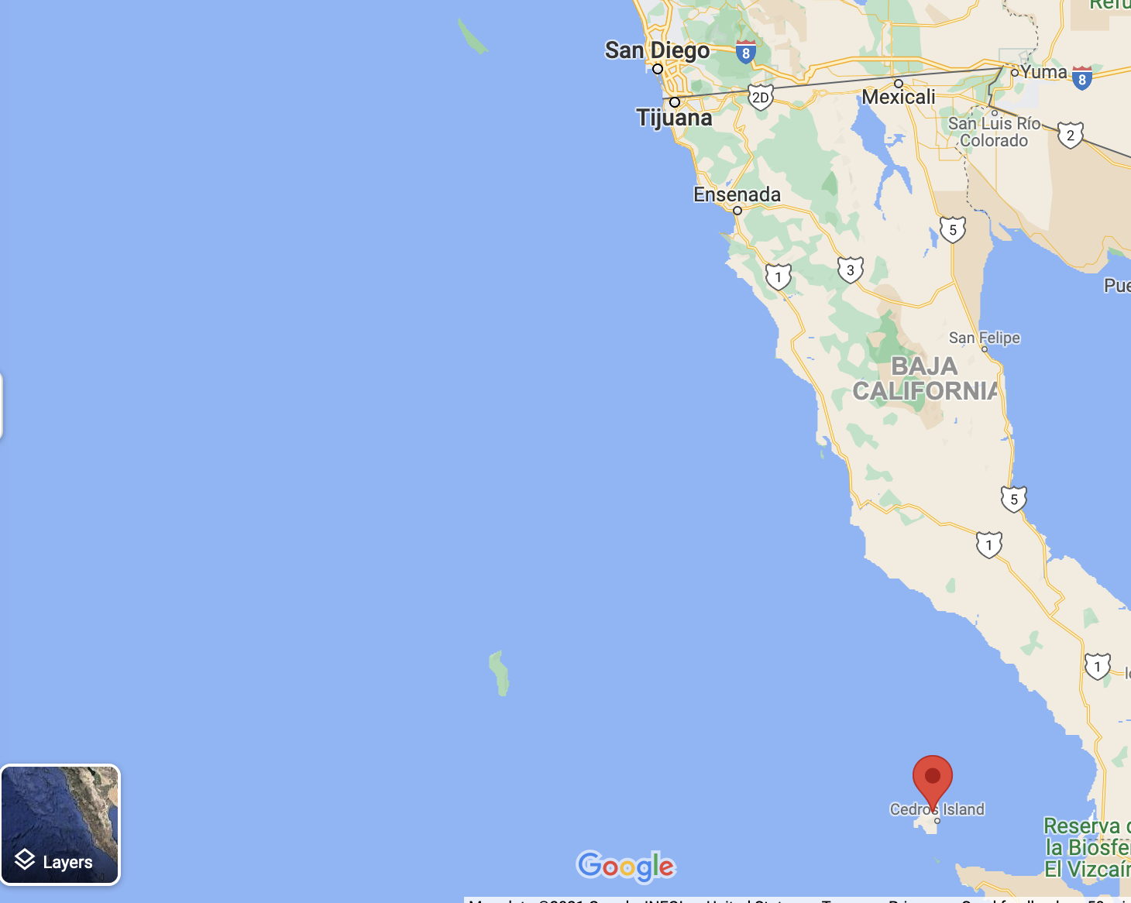
Where is Cedros Island?
It seems some of San Diego’s best fishing isn’t in the US

Slide 25
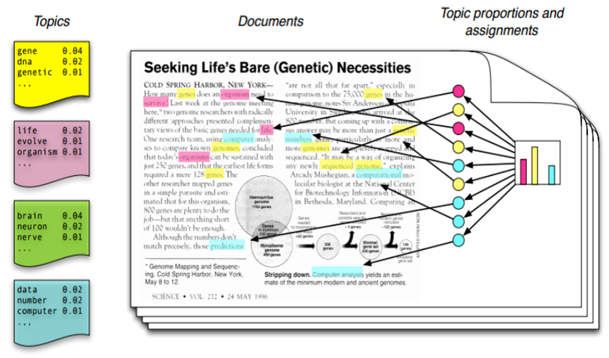
Summarize conversations with topic models

Slide 26
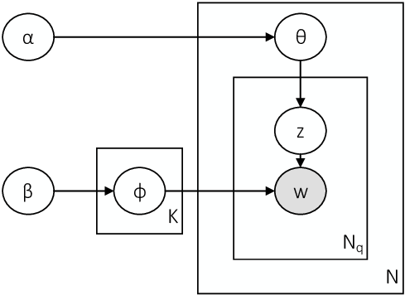
Summarize conversations with topic models
Clean up data
Use topic model library to find conversation types (topics)
Visualize these grouped conversations
Probabilistic, generative plate diagram for LDA

Slide 27
Summarize conversations with topic models
Clean up data - these don’t work well with short, messy tests
Group every word into a conversation (topic) based on how it’s used
Visualize these grouped conversations
Probabilistic, generative plate diagram for LDA

Slide 28
The LDA results

Slide 29
Language and Culture of Boats
We wanted to learn about the boat’s culture and way of operating via text mining
Some cool facts we found:
The boats will go deep into Mexican waters to fish
Yellowfin and Bluefin tuna are extremely popular
There is a jackpot system, where attendees are ranked by their fish size
The posts are used as a channel to broadcast deals

Slide 30
What are they catching, and when?
Need to know:
Timestamps on posts to detect seasonality
Names of fish in order to extract their mentions

Slide 31
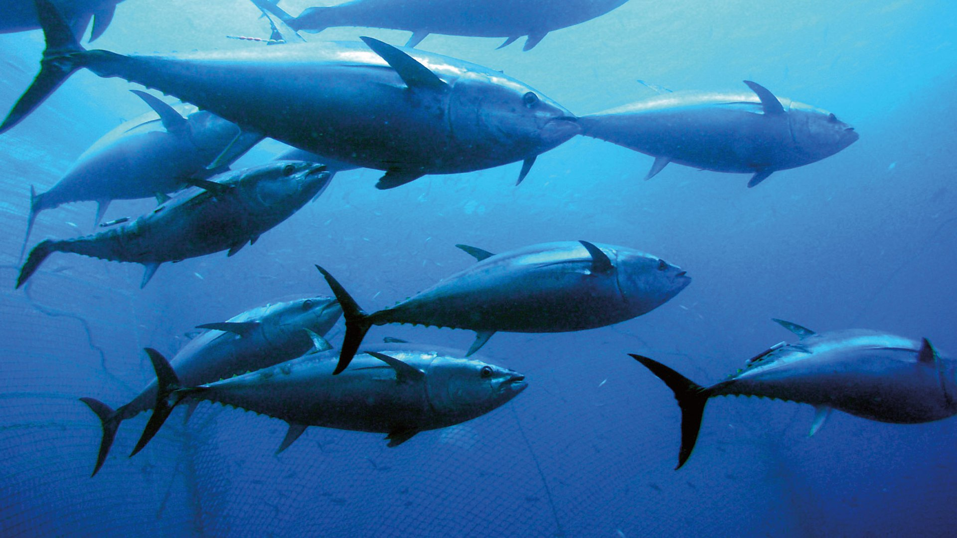
What are they catching, and when?

Slide 32
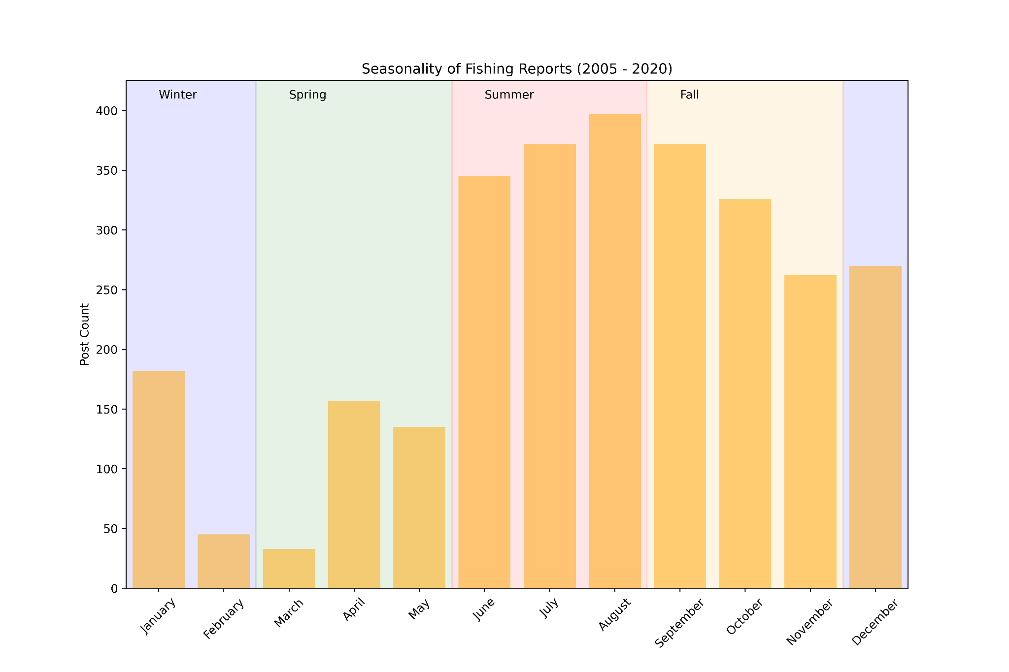

Slide 33
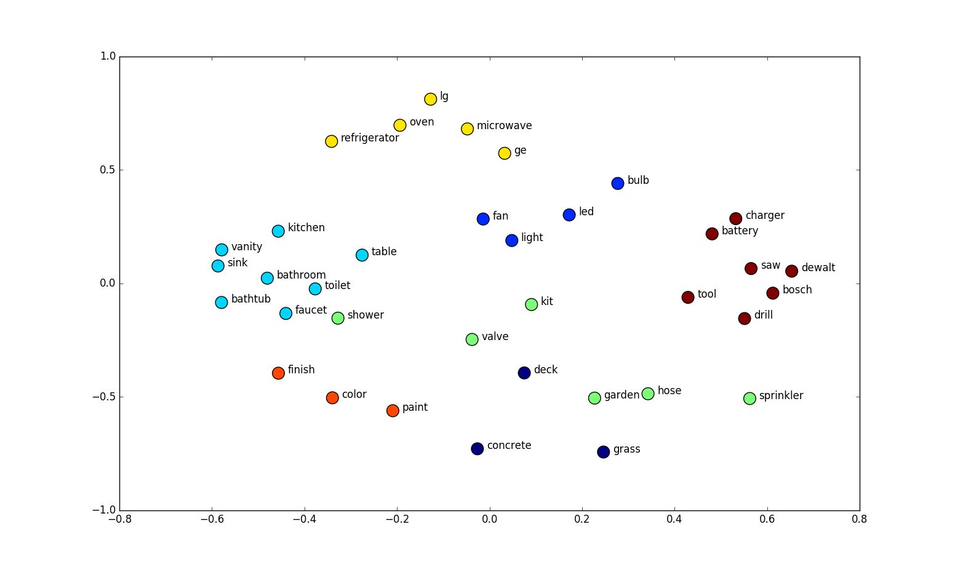
First, which fish exist in San Diego? Try word embeddings

Slide 34
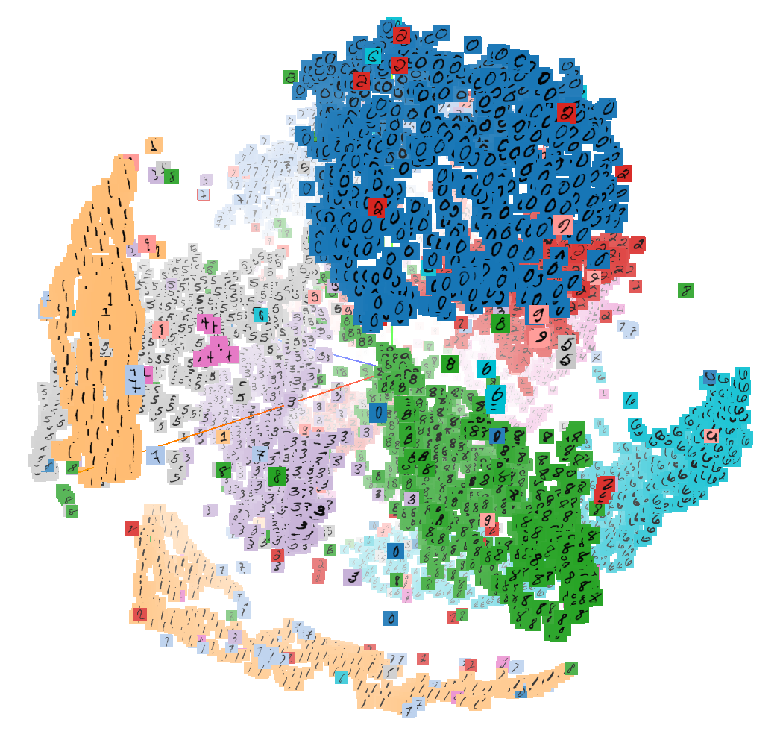
Embeddings provide a way to describe *similarity*
Hand-written digits cluster in this embedding space

Slide 35
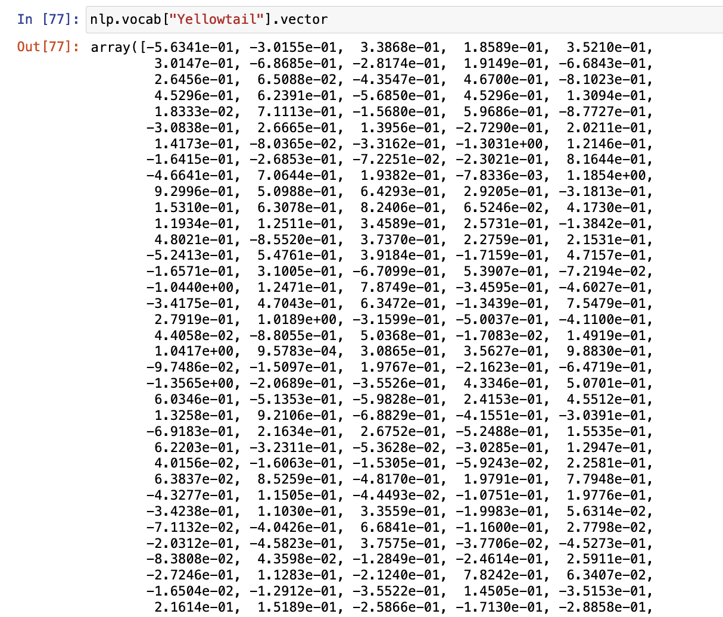
SpaCy gives 300-dimensional word embeddings

Slide 36
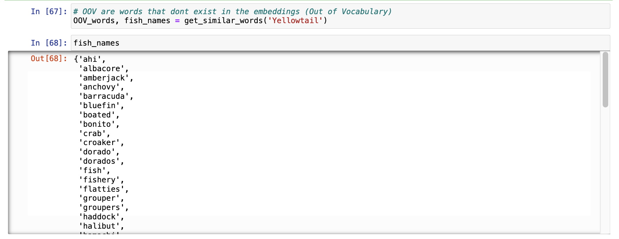
Use a fish name we know to find others

Slide 37
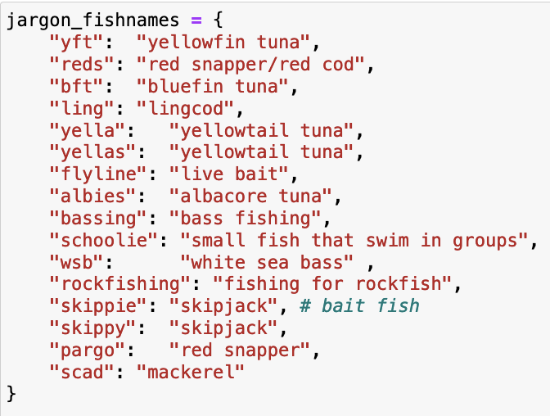
Not all words have an embedding in this library
OOV words are a way to find jargon!

Slide 38
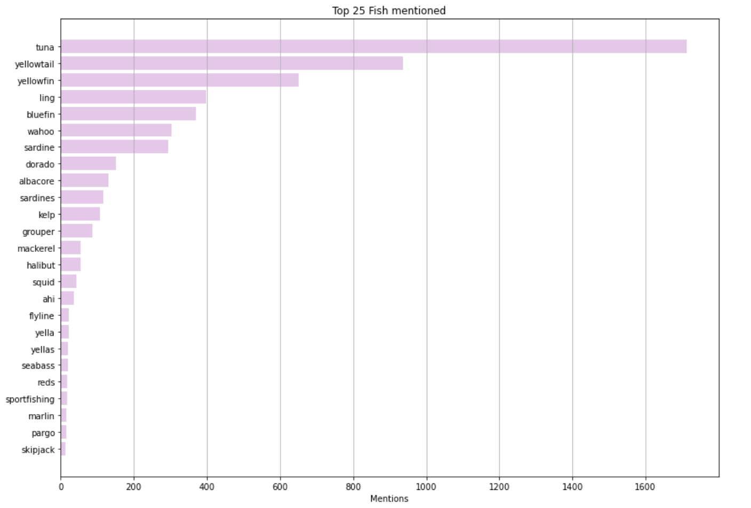
Total Fish mentions

Slide 39
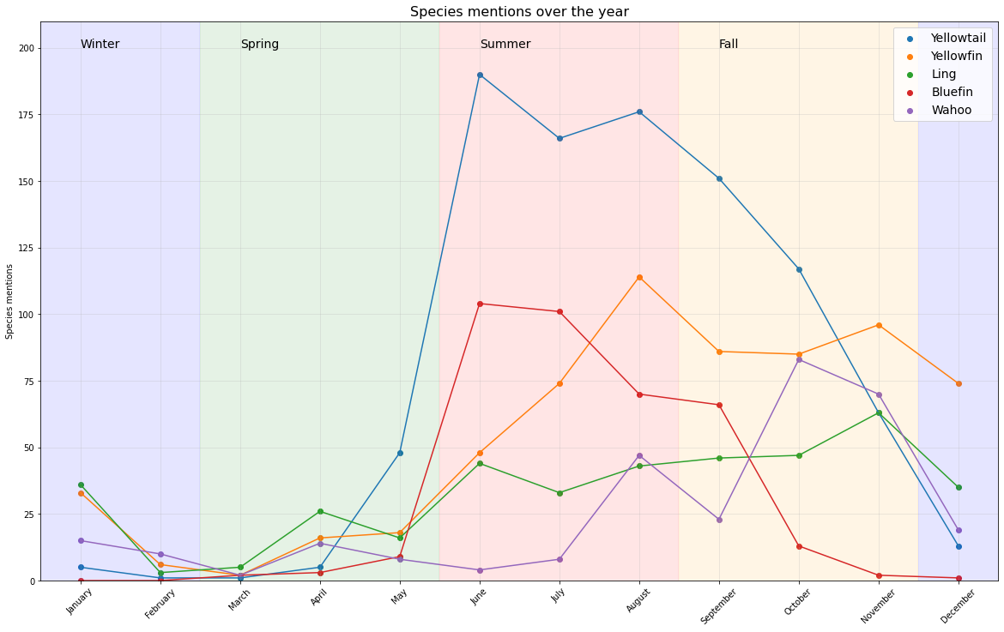

Slide 40
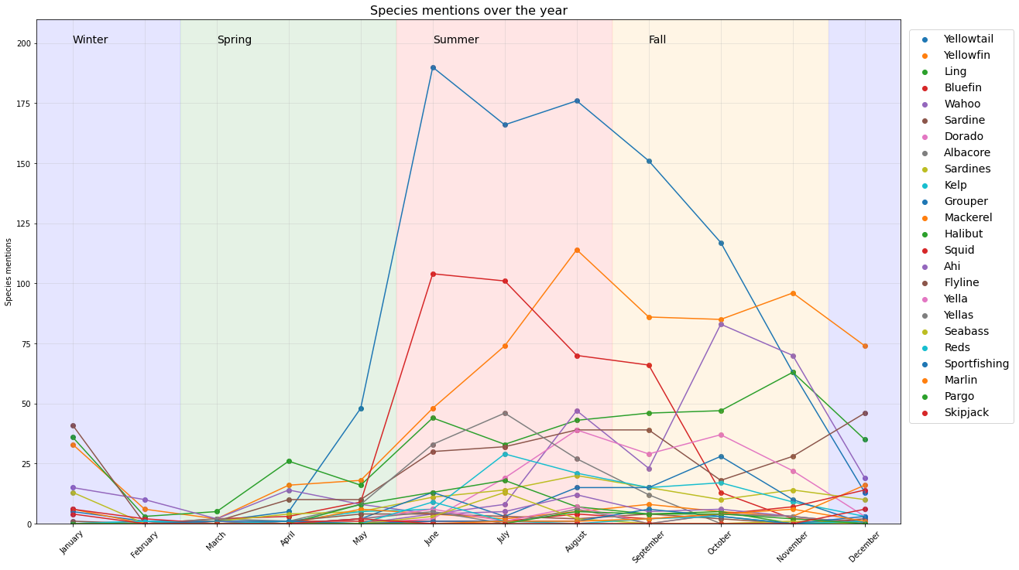

Slide 41
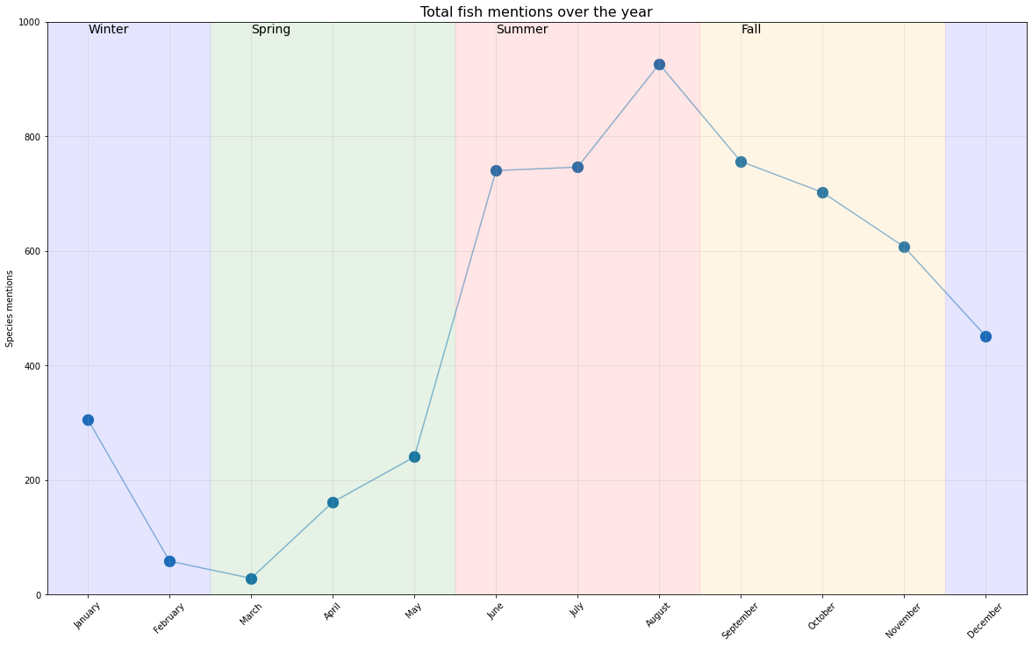

Slide 42
Future work
Extract fish sizes, other quantities
Automated extraction of quantities is hard to get right with natural language
Detect anomalous days
Boats hit limit 45 times in the past 15 years. What conditions led to this?

Slide 43
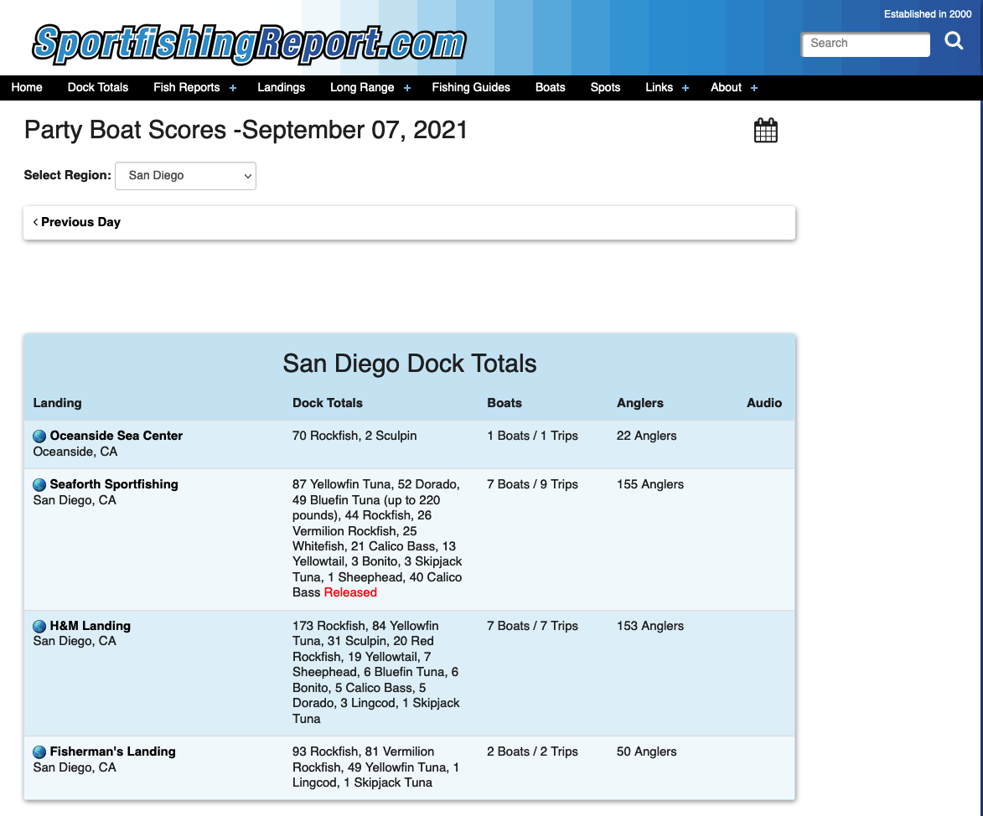

...Some of the data already exists!
(Me when I realized I could have scraped the data directly)

Slide 44
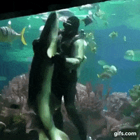
Questions?

Slide 45
Sources
gallery
https://www.independencesportfishing.com/gallery.php
Main site
https://www.independencesportfishing.com/index.php
Good article
https://www.sandiegomagazine.com/features/a-deep-dive-into-the-san-diego-fishing-industry/article_2959b344-d518-5cf0-b2d7-a952673fc231.html

Slide 46
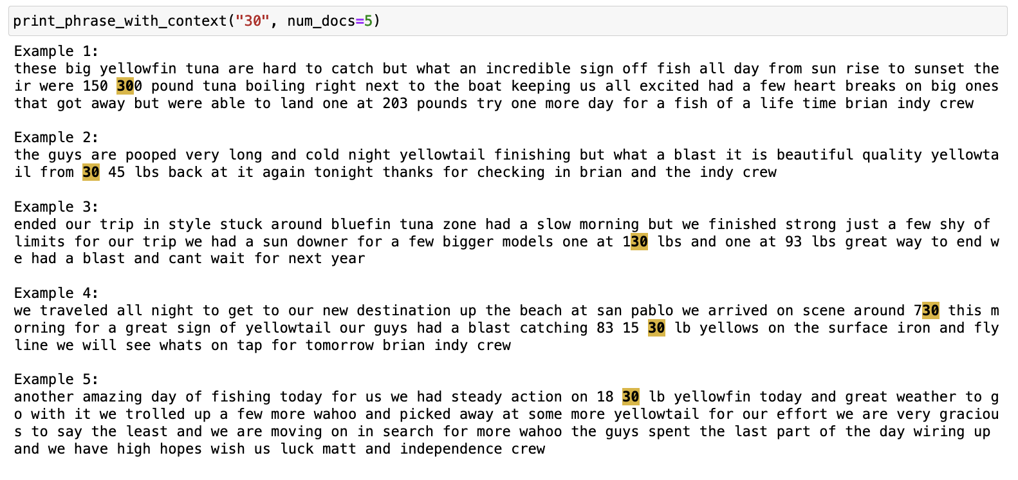
The quantity problem

Slide 47
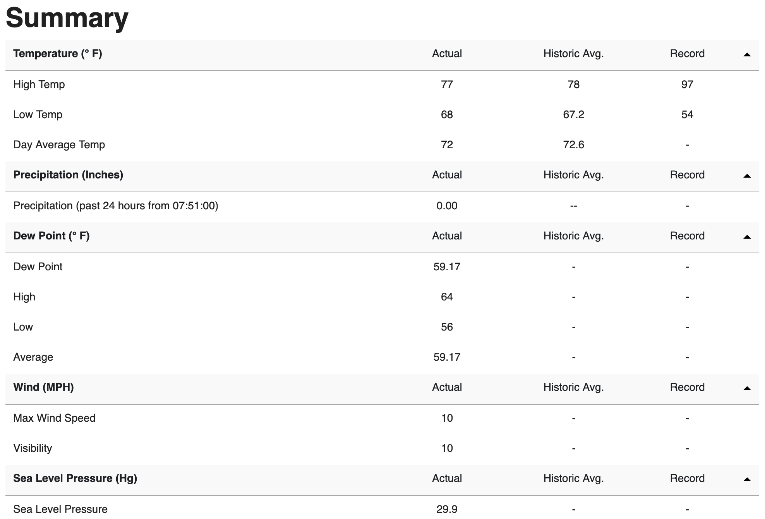

Slide 48
Weather url
https://www.wunderground.com/history/daily/us/ca/san-diego/KSAN

Slide 49
What can we learn?
Language used by fishermen. What do they care about? Is there jargon?
Seasonality of sportfishing - when is the best time? Does temperature matter?
Fish species - what’s in SD, and how are they discussed?

Slide 50
Catch of the Day (🐠 Agenda 🐠)
A brief history of fishing in San Diego
Goal
Programatically understand fishing patterns
Approach
Data collection
Cleaning
Main analysis
Future work
Notes:
https://www.sandiegomagazine.com/features/a-deep-dive-into-the-san-diego-fishing-industry/article_2959b344-d518-5cf0-b2d7-a952673fc231.html
Article that highlights rebound of tuna populations and sustainable fishing in san diego

Slide 51
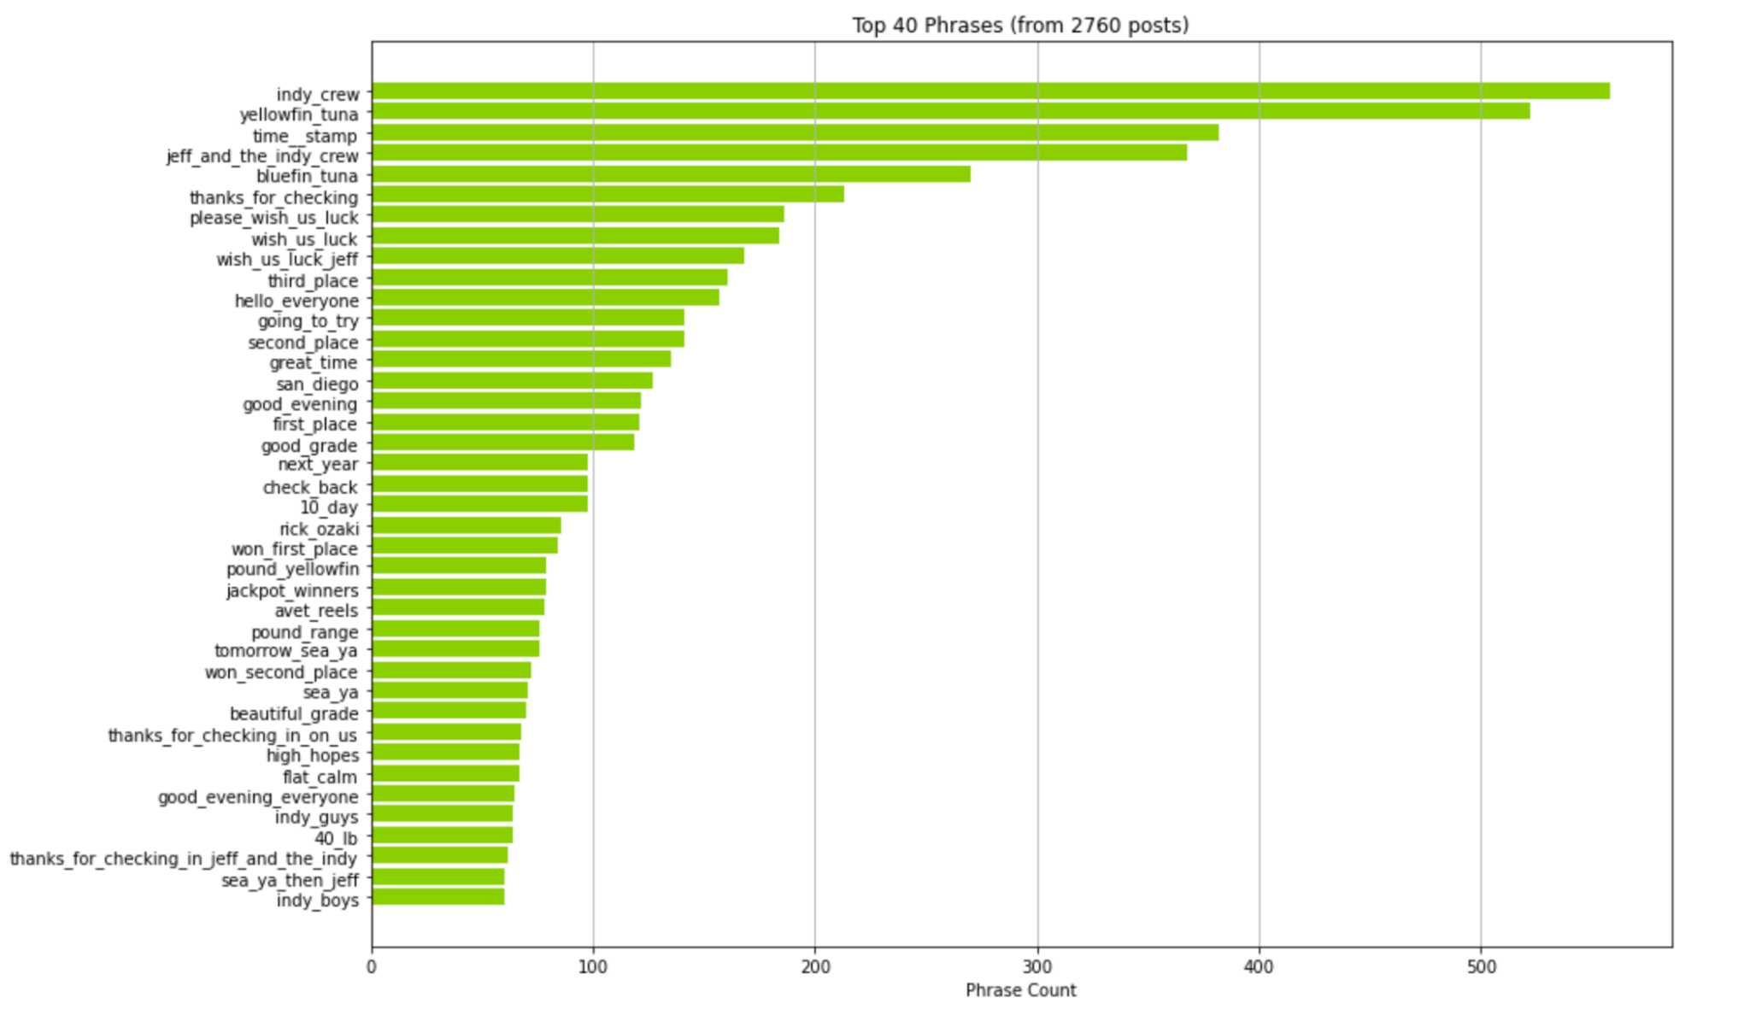
Top phrases

Slide 52
Which fish do they catch? Try word embeddings
Hand-written digits cluster in this embedding space

Slide 53
Which fish do they catch? Try word embeddings

Slide 54
Which fish do they catch? Try word embeddings
Hand-written digits cluster in this embedding space

Slide 55
Embeddings provide a way to describe *similarity*

Slide 56
Collecting data

Slide 57
What is “Cedros Island”?
Example 1:
captian mark pisano called in from the independence this afternoon with an update from cedros island we are in the middle of a 6 day trip we had excellent fishing for two days on nice grade bluefin tuna the majority of the bluefin were in the 50 to 70 pound class we are currently fishing nice big yellowtail at isla cedros and we will be visiting the offshore grounds for tuna on the way back home it has been a great trip we will update you in a couple days
Example 2:
hello again we had good fishing and weather today the main target species was yellowfin tuna and the fishing was slower for the tuna however we did pick up a fair share to go along with lots of yellowtail and dorado that we released currently cedros island is the next stop to enjoy the scenery and weather along with a little catch and release calico bass have a good day the indy crew
Example 3:
wide open yellowtail chad woods with live update from cedros island aboard the independence they already got 150 yellowtail from this morning theyre biting surface iron yo yoing jigs and live sardines theyll probably get limits shortly more updates to come call judy at independence sportfishing at 619 226 6006 to book your next trip dont miss out

